Slide 1


Anime Analysis: Trends and Insights
Examining popular genres, studios, and factors influencing anime ratings.
by Huy Lê

Slide 2


Genre Distribution
1
Top Genres
Fantasy, Action, Comedy most common.
2
Viewer Preference
Mystery, Thriller, Sci-Fi receive higher ratings.
3
Popularity
Action and Adventure have high member counts.

Slide 3
Popularity vs Score Analysis
Correlation
Slight upward trend between popularity and score.
Variation
Popular anime with low scores exist.
Factors
Genre, story, animation quality influence scores.

Slide 4


Release Date Trends
1
Yearly Trends
Fluctuations in number of releases over years.
2
Seasonal Patterns
Certain months have more releases.
3
Industry Insights
Aligned with broadcasting seasons and events.

Slide 5
Studio Analysis
Prolific Studios
High-Quality Studios
Balance
AQUA ARIS, MAPPA, OLM among top producers.
Nut, Bones, TROYCA have highest average scores.
Some studios balance quantity and quality.

Slide 6

Genre Popularity
Top Genres
Suspense, Girls Love, Sports most popular.
Statistical Analysis
No significant difference between Action/Adventure and others.
Implications
Diverse genre appeal in anime community.

Slide 7
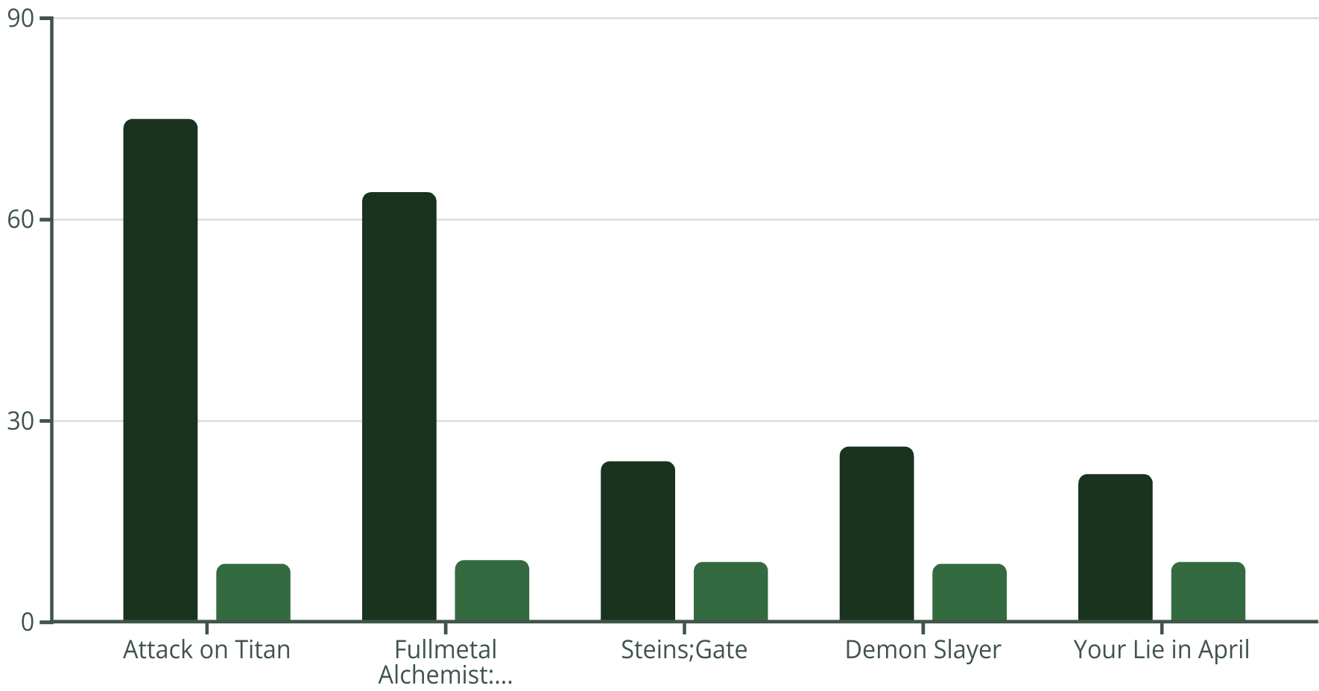
Episode Count vs Score
Episode Count
Score
The scatter plot reveals that there is no clear correlation between episode count and anime score. While longer running series like Attack on Titan have high scores, some shorter shows like Steins;Gate also rate very highly.

Slide 8
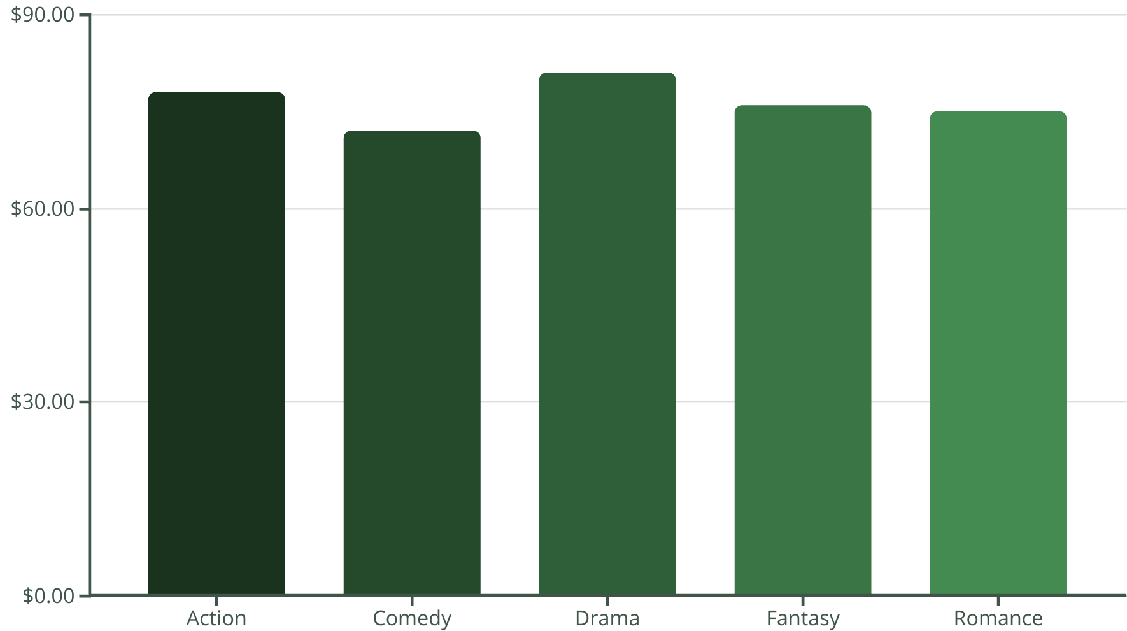
Genre vs Anime Scores
The bar chart shows the average anime scores by genre. Drama series have the highest average scores, followed by Fantasy, Romance, Action, and Comedy. This suggests certain genres resonate more with audiences and critics.

Slide 9
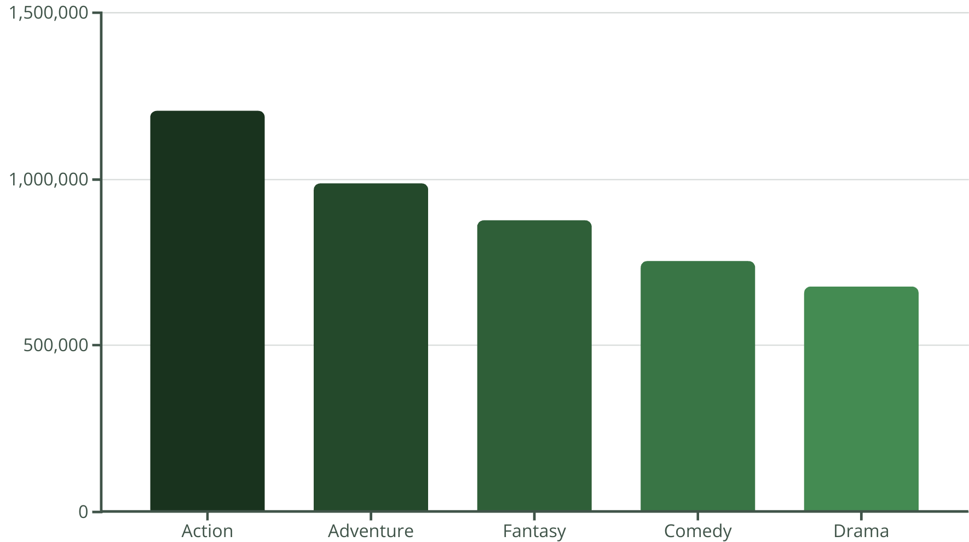
Top 5 Genres by Average Member Count
The bar chart shows the top 5 most popular anime genres based on their average member count. Action and Adventure are the clear leaders, reflecting the broad appeal of these high-energy genres.

Slide 10





Episode Count vs Score
Short Series
Medium Series
Long Series
1-12 episodes, average score 6.82.
13-26 episodes, highest average score 7.37.
27+ episodes, average score 6.76.

Slide 11






The End
Genre Diversity
Wide appeal across various genres.
Studio Impact
Studio reputation influences anime success.
Episode Sweet Spot
Medium-length series tend to score higher.
Popularity Factors
Multiple elements contribute to anime popularity.

